Slide 1
بسم الله الرحمن الرحیم
Notes:
Introduce yourself
ان شاء الله که وخت خوب و پربرکت خواهیم داشت

Slide 2
CS101 Introduction to Computer Science

Slide 3
Lecture 8

Slide 4
reading levels

Slide 5
cryptography

Slide 6
compiling

Slide 7
preprocessing
compiling
assembling
linking

Slide 8
preprocessing
compiling
assembling
linking

Slide 9
...
main: # @main
.cfi_startproc
# BB#0:
pushq %rbp
.Ltmp0:
.cfi_def_cfa_offset 16
.Ltmp1:
.cfi_offset %rbp, -16
movq %rsp, %rbp
.Ltmp2:
.cfi_def_cfa_register %rbp
subq $16, %rsp
xorl %eax, %eax
movl %eax, %edi
movabsq $.L.str, %rsi
movb $0, %al
callq get_string
movabsq $.L.str.1, %rdi
movq %rax, -8(%rbp)
movq -8(%rbp), %rsi
movb $0, %al
callq printf
...

Slide 10
reverse engineering
Notes:
intellectual property

Slide 11
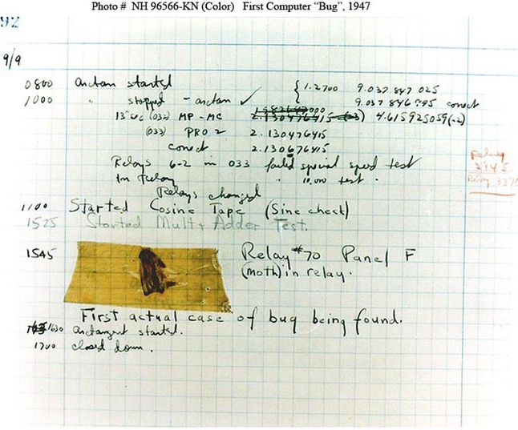
Notes:
"First actual case of bug being found", now in Smithsonian

Slide 12
arrays

Slide 13
int scores[3];
scores[0] = 72;
scores[1] = 73;
scores[2] = 33;
Notes:
scores1.c

Slide 14
72 scores[0] |  |  |  | 73 scores[1]
33 scores[2]
Notes:
scores{2,3,4,5}.c

Slide 15
char c1 = 'H';
char c2 = 'I';
char c3 = '!';
Notes:
hi{0,1}.c
what about chars?

Slide 17
H c1 | I c2 | ! c3

Slide 18
72 c1 | 73 c2 | 33 c3

Slide 19
01001000 c1 | 01001001 c2 | 00100001 c3

Slide 20
string
Notes:
most types have fixed length, so how implement strings?

Slide 21
string s = "HI!";
Notes:
hi2.c

Slide 23
H | I s | !
Notes:
hi3.c

Slide 24
H s[0] | I s[1] | ! s[2]
Notes:
How know where end is?

Slide 25
H s[0] | I s[1] | ! s[2] | 00000000 s[3]

Slide 26
H s[0] | I s[1] | ! s[2] | 0 s[3]

Slide 27
H s[0] | I s[1] | ! s[2] | \0 s[3]

Slide 28
72 s[0] | 73 s[1] | 33 s[2] | 0 s[3]
Notes:
hi4.c

Slide 29
H s | I | ! | \0

Slide 30
NUL

Slide 31
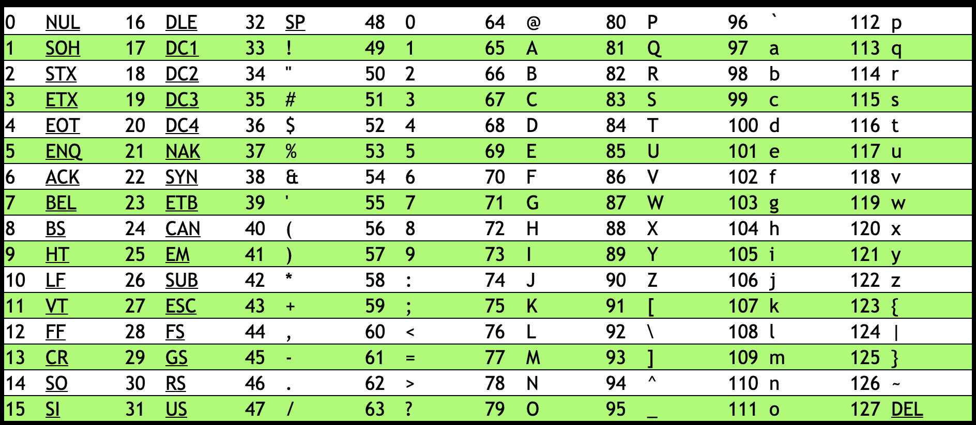
Notes:
https://asciichart.com/

Slide 32
Notes:
https://asciichart.com/

Slide 33
string s = "HI!";
string t = "BYE!";
Notes:
hi5.c

Slide 35
H s | I | ! | \0

Slide 36
H s | I | ! | \0 | B t | Y | E | !
\0

Slide 37
H s[0] | I s[1] | ! s[2] | \0 s[3] | B t[0] | Y t[1] | E t[2] | ! t[3]
\0 t[4]

Slide 38
string words[2];
words[0] = "HI!";
words[1] = "BYE!";
Notes:
hi6.c

Slide 39
H words[0] | I | ! | \0 | B words[1] | Y | E | !
\0

Slide 40
H words[0][0] | I words[0][1] | ! words[0][2] | \0 words[0][3] | B words[1][0] | Y words[1][1] | E words[1][2] | ! words[1][3]
\0 words[1][4]
Notes:
hi7.c

Slide 41
string
Notes:
length{0,1}.c

Slide 42
string.h

Slide 43
manual.cs50.io/#string.h

Slide 44
strlen
Notes:
length2.c
string{0,1}.c

Slide 45
ctype.h

Slide 46
manual.cs50.io/#ctype.h

Slide 47
Notes:
https://asciichart.com/

Slide 48
Notes:
uppercase{0,1,2}.c
https://asciichart.com/

Slide 49
command-line arguments
Notes:
make, cd, etc.

Slide 50
#include <stdio.h>
int main(void) {
...
}

Slide 51
#include <stdio.h>
int main(void) {
...
}

Slide 52
#include <stdio.h>
int main(int argc, string argv[]) {
...
}
Notes:
greet{0,1,2,3,4}.c

Slide 53
ASCII art

Slide 54
cowsay
Notes:
cowsay moo
cowsay -f duck quack
cowsay -f dragon RAWR

Slide 55
exit status

Slide 56
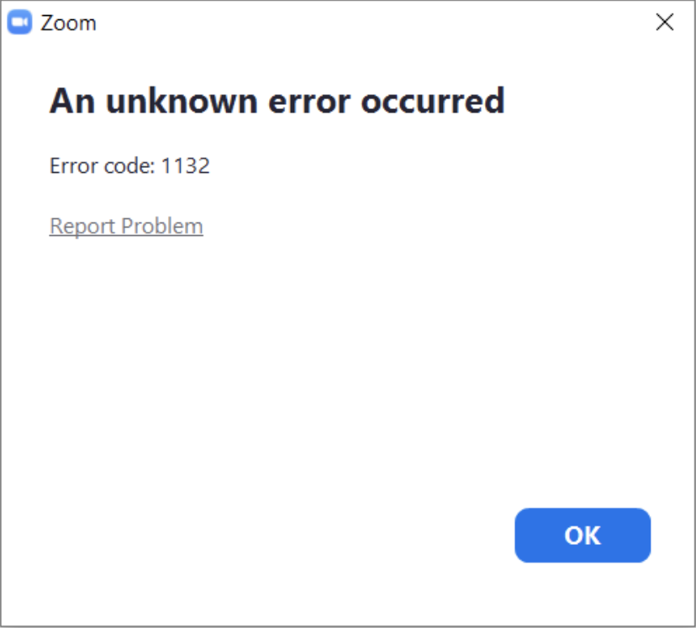
Notes:
https://community.zoom.com/t5/Meetings/ERROR-1132/td-p/40521

Slide 57
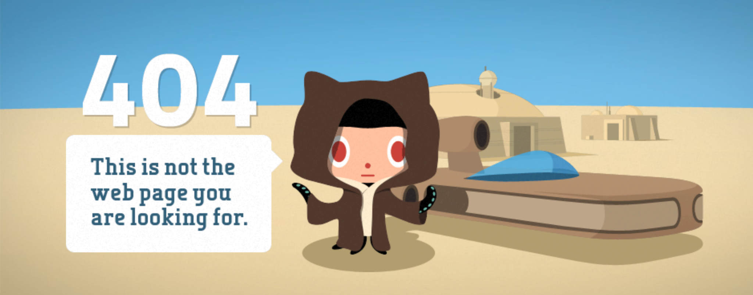
Notes:
https://github.com/

Slide 58
#include <stdio.h>
int main(int argc, string argv[]) {
...
}

Slide 59
#include <stdio.h>
int main(int argc, string argv[]) {
...
}

Slide 60
#include <stdio.h>
int main(void) {
...
}
Notes:
status.c

Slide 61
echo $?
Notes:
useful for TFs' testing students code (or testing code in industry in automated processes)

Slide 62
cryptography

Slide 63
encryption

Slide 64
input →
→ output

Slide 65
plaintext →
→ ciphertext

Slide 66
cipher
plaintext →
→ ciphertext

Slide 67
cipher
key →
plaintext →
→ ciphertext

Slide 68
1 →
HI! →

Slide 69
1 →
HI! →
→ IJ!

Slide 70
13 →
HI! →
→ UV!

Slide 71
13 →
I LOVE YOU →
→ V YBIR LBH

Slide 72
26 →
I LOVE YOU →

Slide 73
26 →
I LOVE YOU →
→ I LOVE YOU

Slide 74
decryption

Slide 75
-1 →
UIJT XBT DT50 →

